Slide 1
PillEasy
By:
Harshit Gupta (MT21028)
Madiha Tariq (MT21125)
Mohnish Basarkar (MT21052)
Niharika (MT21132)
Shrey Rastogi (MT21145)
Team Name:- SlowCodeTransform

Slide 2
ABSTRACT
This is an Android-based application which will comprise of automatic alarm notifications based on the medicine schedule given by the user.The alarm can be set for multiple medicines and timings including continuous/ interval dates, time and medicine description along with the medicine strip images. A notification will be sent to the user, using system sound along with a pop-up option to mark medicine as Taken/Reschedule. The medicines can be added, deleted or edited wherever required. Also the user will be able to keep a track of their daily health updates by adding their Blood Pressure,Diabetes and weight, that will be shown at one place on a button click and can be downloaded. The user can save their prescriptions in the application. Additionally, the medicine names can be extracted from the strip images uploaded by the user.

Slide 3
MOTIVATION
The motivation to build this product came from observing the elderly people in the family having to suffer through the stress of missing out pills in absence of regular supervision.
Many times hospitals also display lack of supervision. People sometimes take incorrect medicines due to lack of information or misjudgement. Neither do they have a proper listing of the medicines they are taking and when to consume them. All these happenings motivated us to come up with an easy solution for the aged and the ailing.

Slide 4
RELATED WORK
There are many apps in this domain and the main players are MyTherapy Pill Reminder and Medisafe Pill Reminder and Medication Tracker both of them have more than 10 lakhs + downloads but they all lack one main functionality which is showing the photo of a medicine also while taking or shopping for the same medicine as many people have different pronunciation for the same medicine.

Slide 5
FEATURES OFFERED BY THE APP
Welcome walkthrough Screen
Register and Login
User can add or delete medicine
Category of medicine(pill/spray/injection) can be added along with medicine
Add corresponding medicine strip image
Multiple reminders i.e. if medicine is taken twice or thrice a day
Keeps track of blood pressure, sugar and stored them in sqlite database.
Add and save images of prescription
Medicine names can be extracted from the medicine strips (using Computer Vision)
User can add, delete or edit the medicine
Scheduling of medicine
User can edit medicine doses, alarm.
Monthly generated report of user will be sent through email entered during registration.

Slide 6
FEATURES IMPLEMENTED SO FAR
FEATURES YET TO IMPLEMENT
Add and save images of prescription
The monthly report of Health updates to be sent to the login Email in a pdf format.
Users can edit the Medicine doses, alarm times etc.
Medicine names can be extracted from the medicine strips (using Computer Vision)
With the reminder there is a pop-up that has options as (Take/Ignore)
If you click on ‘take’, the notification/ alarm will be set to off,otherwise
Notification will snooze for some time and again remind you of the medicine with notification sound.
Welcome walkthrough Screen
Register and Login
User can add or delete medicine
Category of medicine(pill/spray/injection) can be added along with medicine
Add corresponding medicine strip image
Multiple reminders i.e. if medicine is taken twice or thrice a day
Keeps track of blood pressure, sugar and stored them in sqlite database.
User can add or delete medicine
Scheduling of medicine

Slide 7
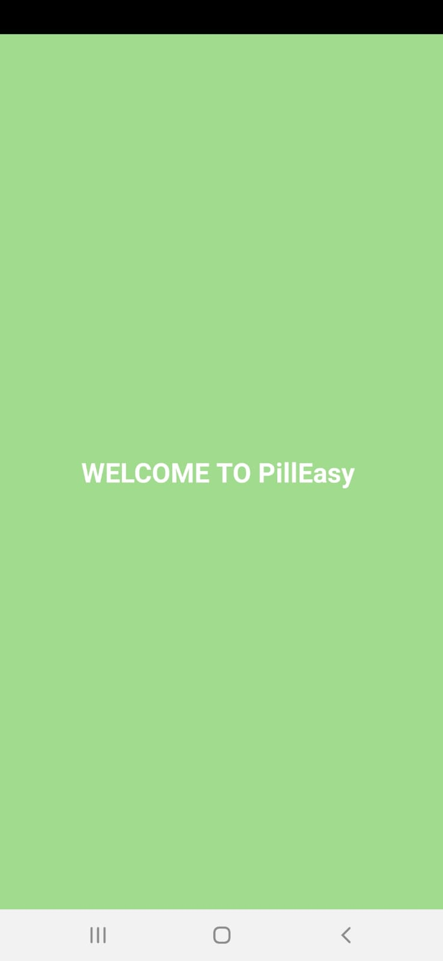
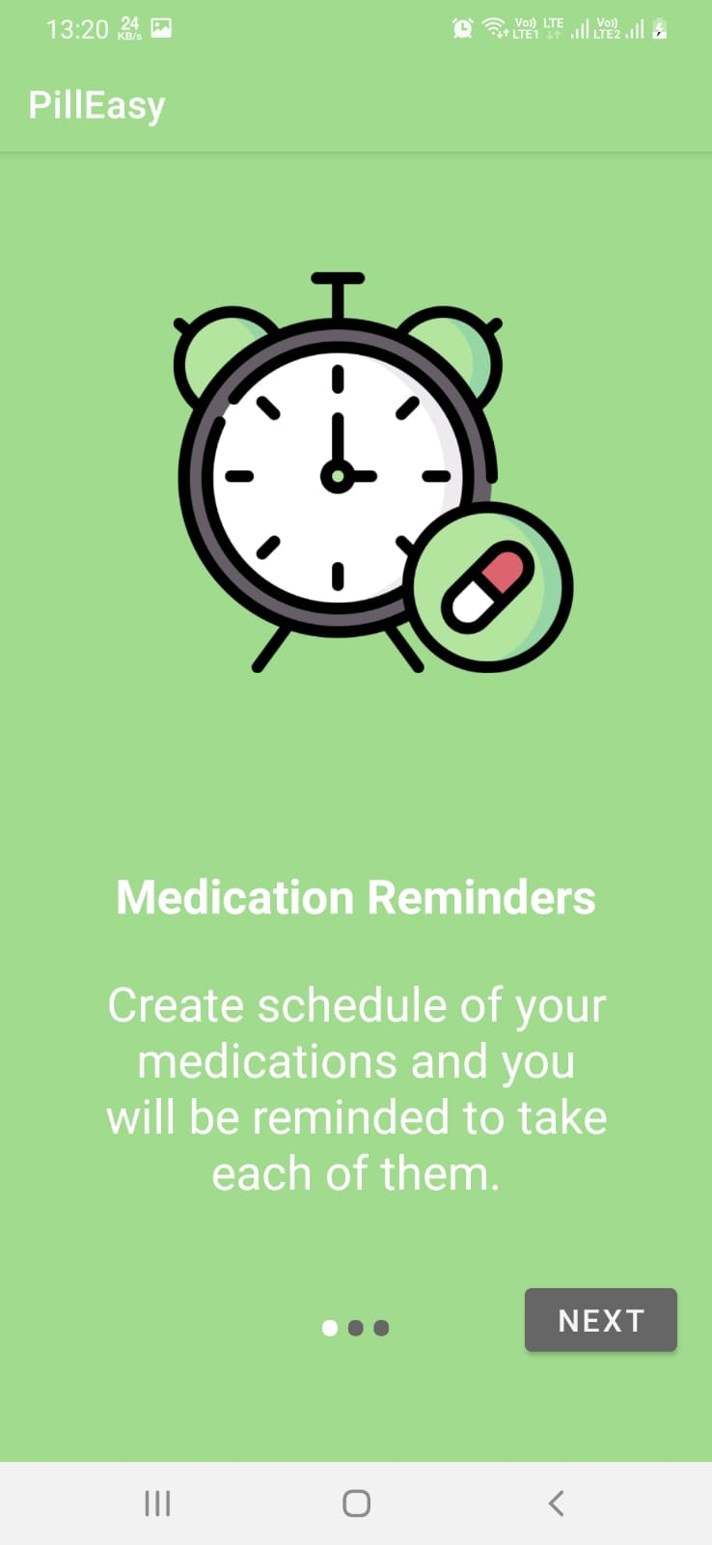
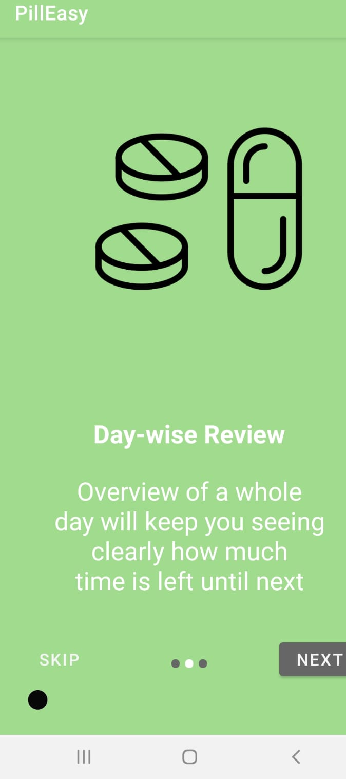
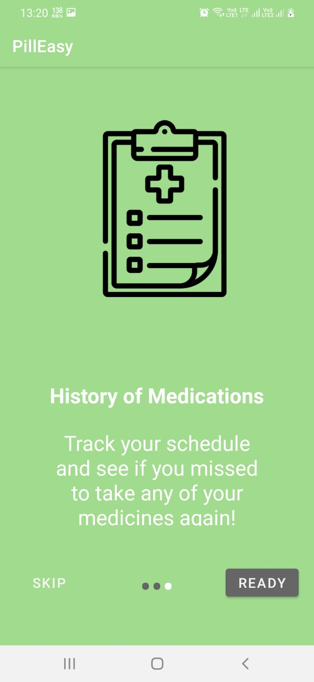
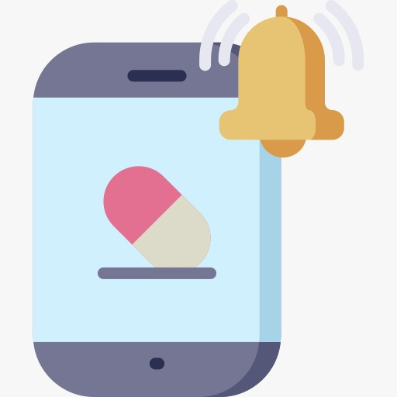
WORKING DEMO ACTIVITY-1
Icon of app

Slide 8
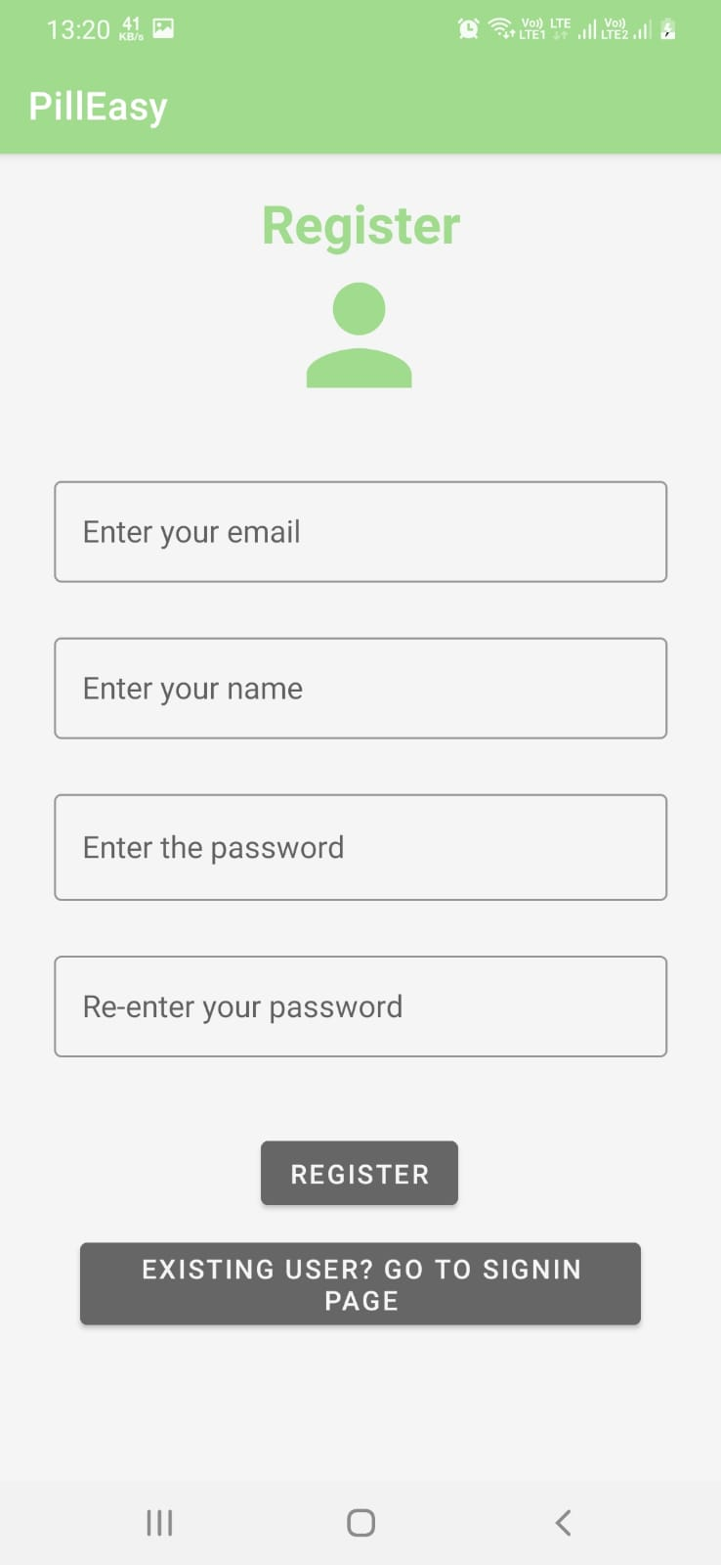
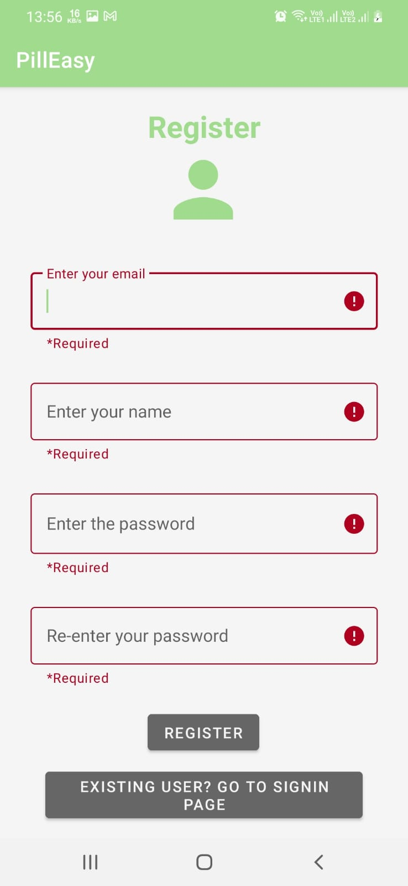
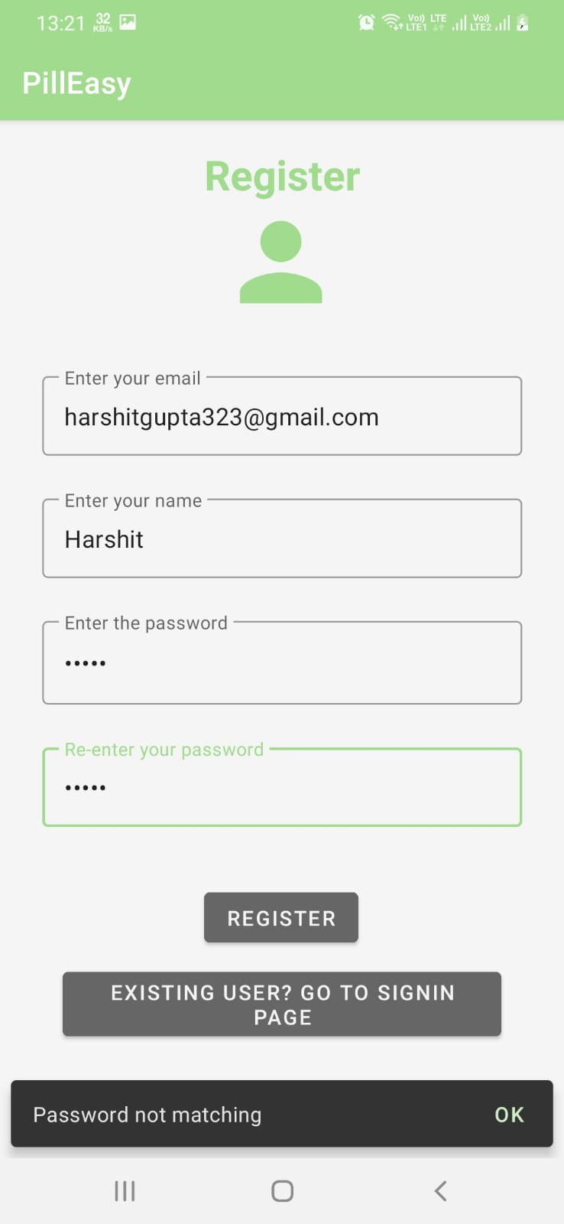
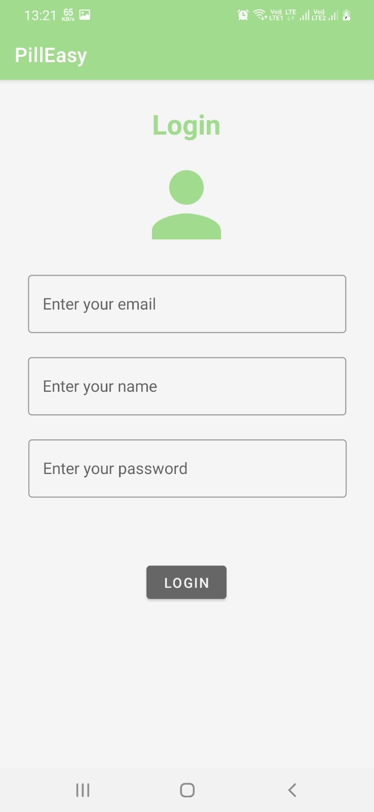
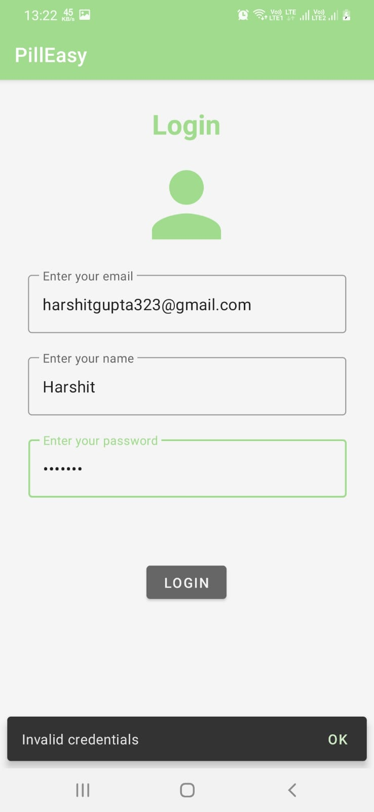
WORKING DEMO ACTIVITY-2

Slide 9
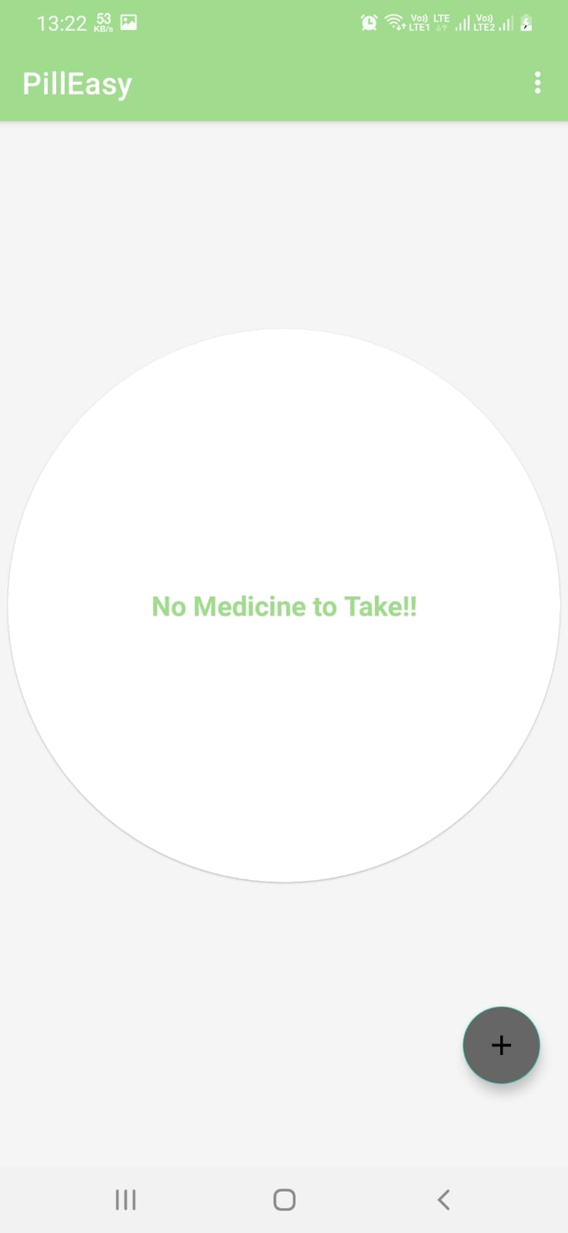
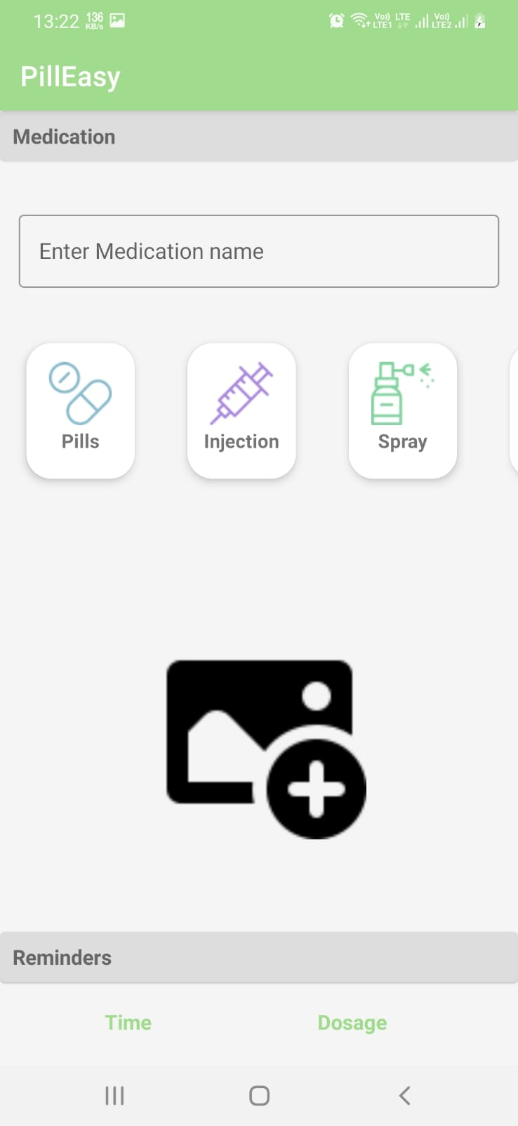
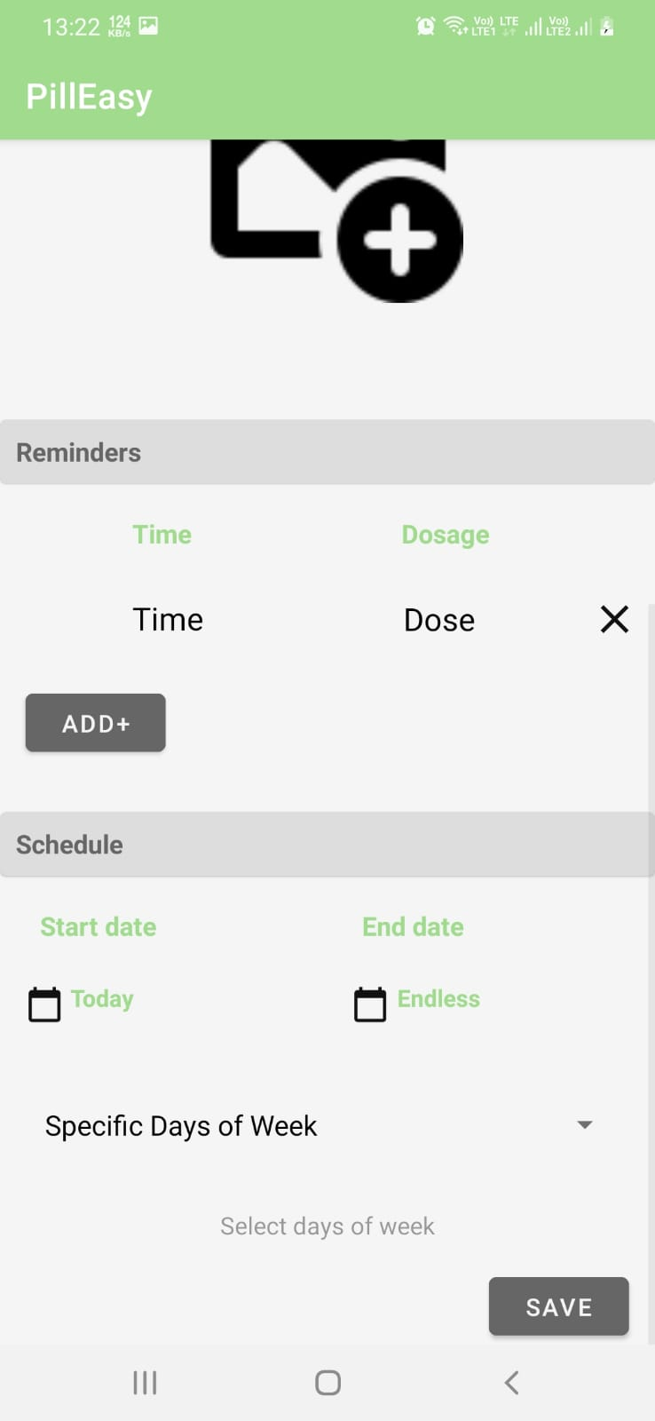
WORKING DEMO ACTIVITY-3

Slide 10
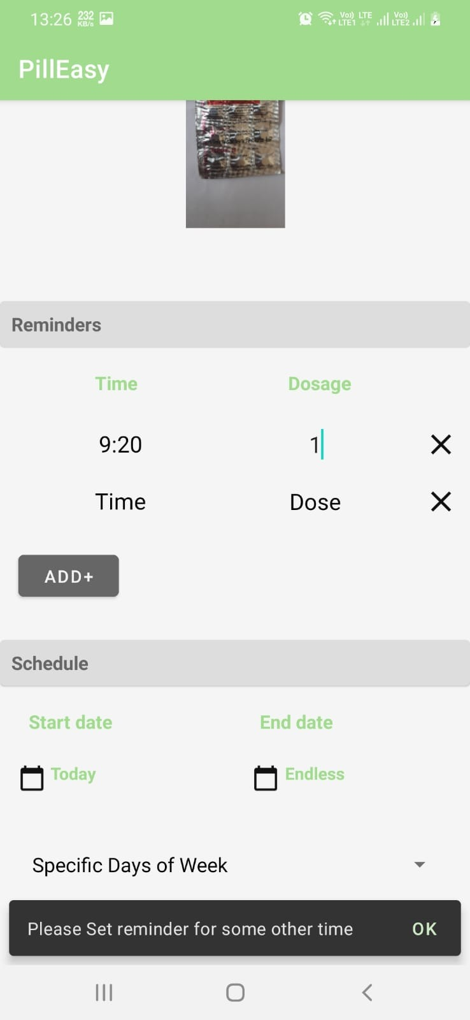
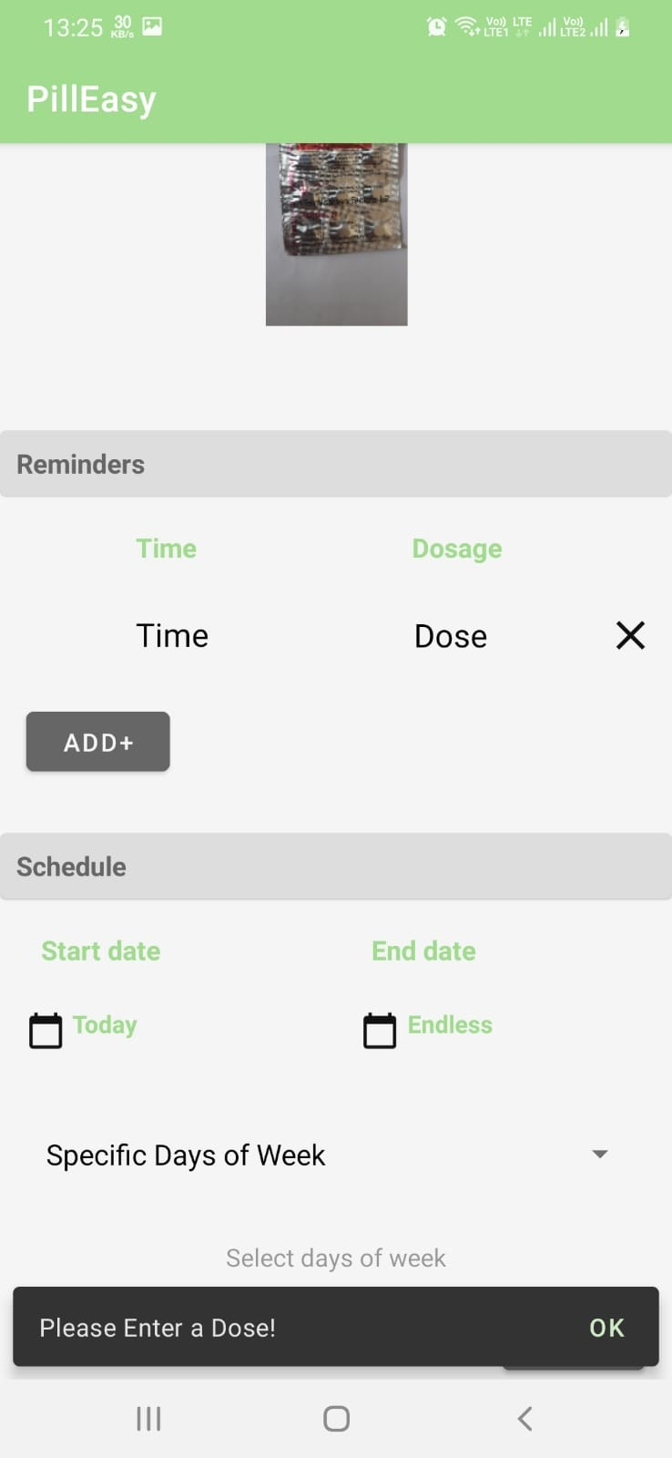
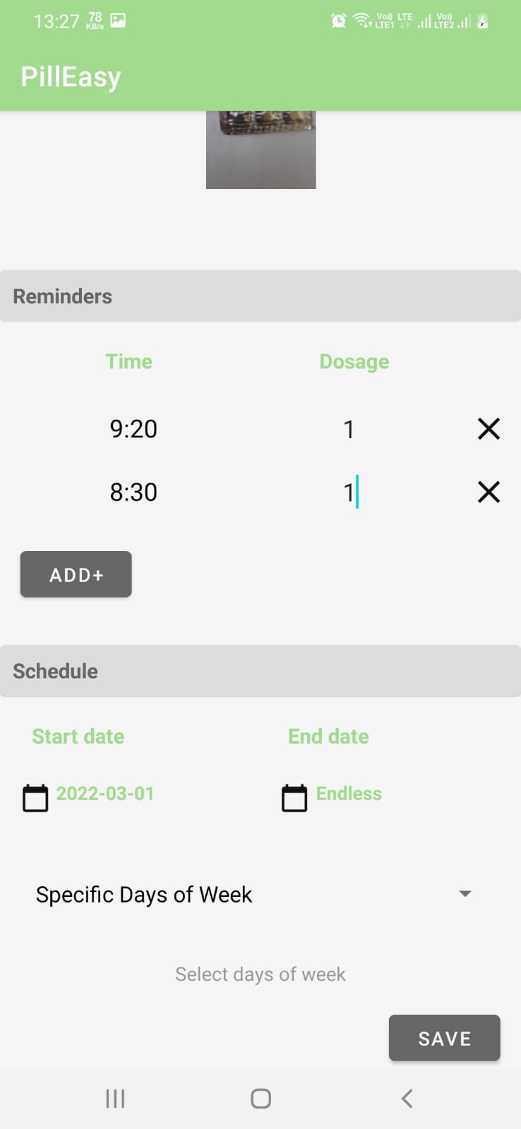
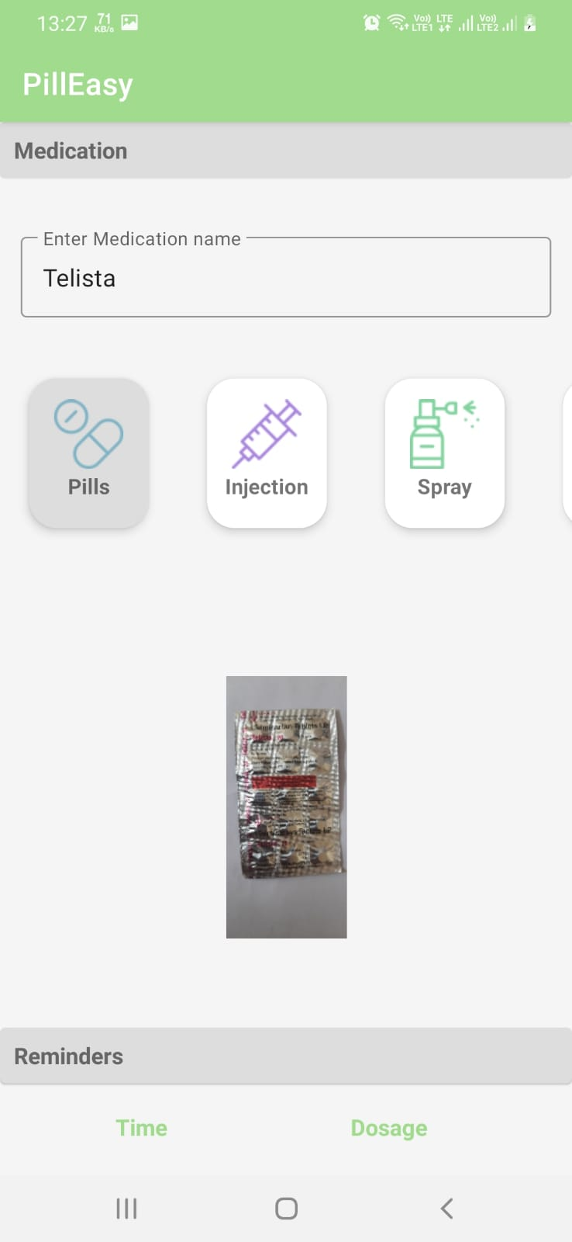
WORKING DEMO ACTIVITY-4

Slide 11
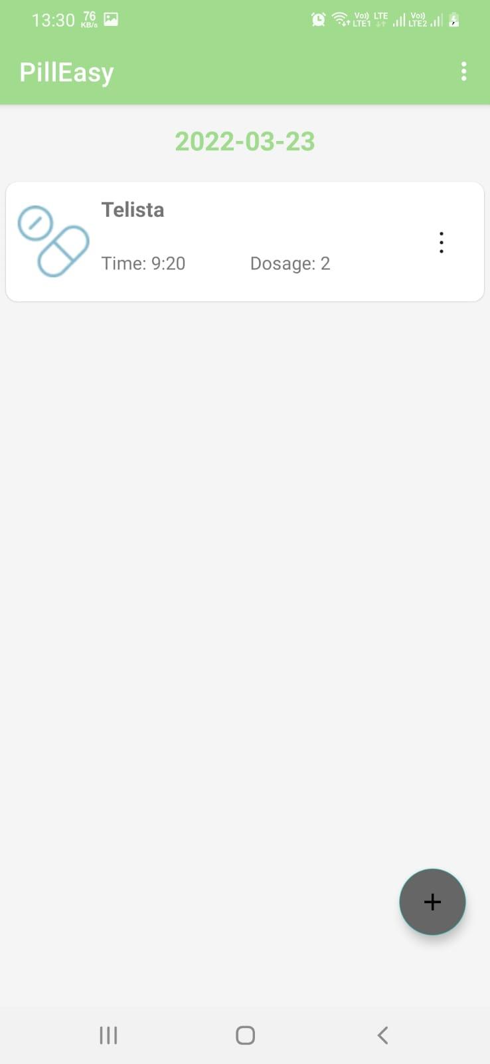
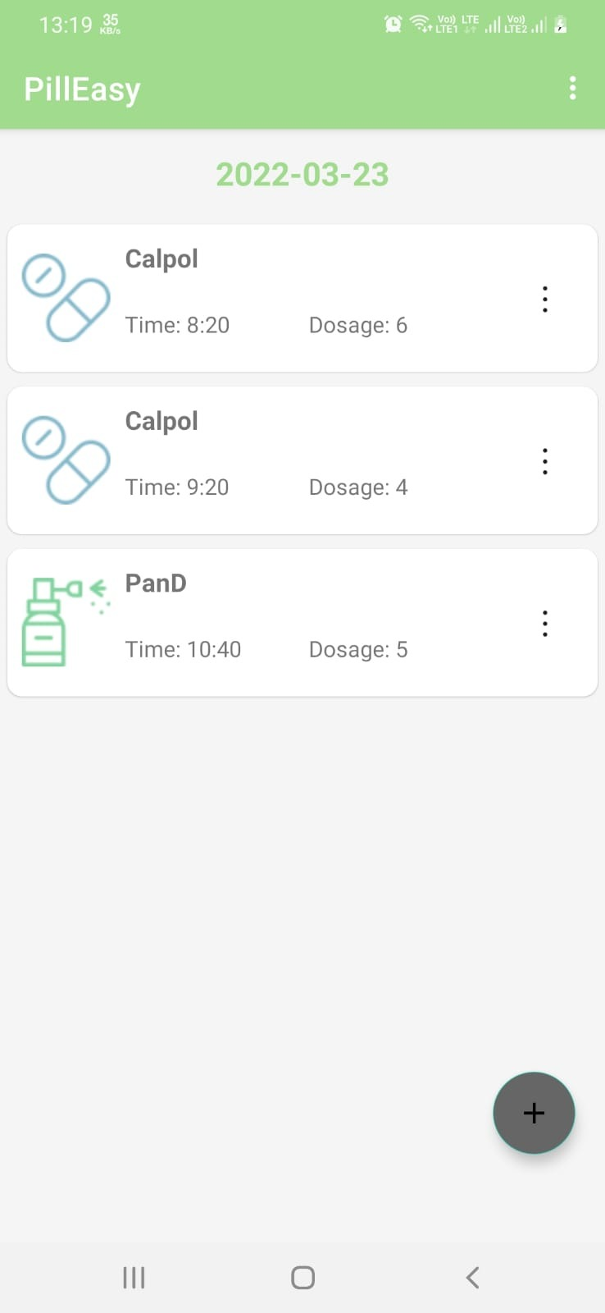
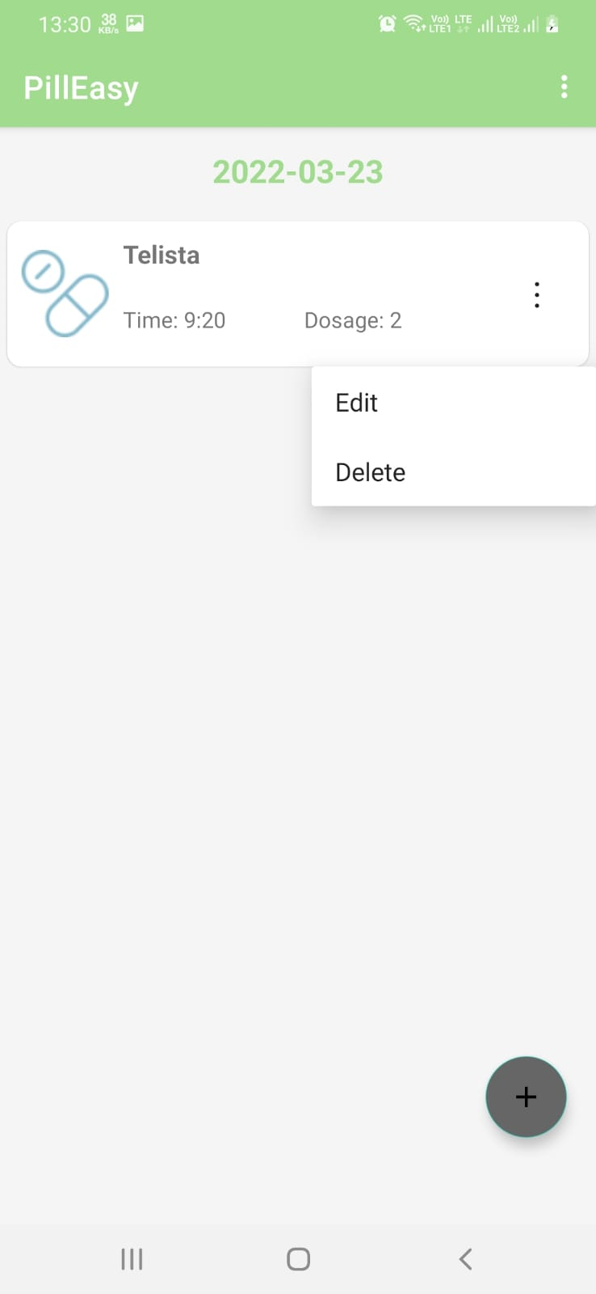
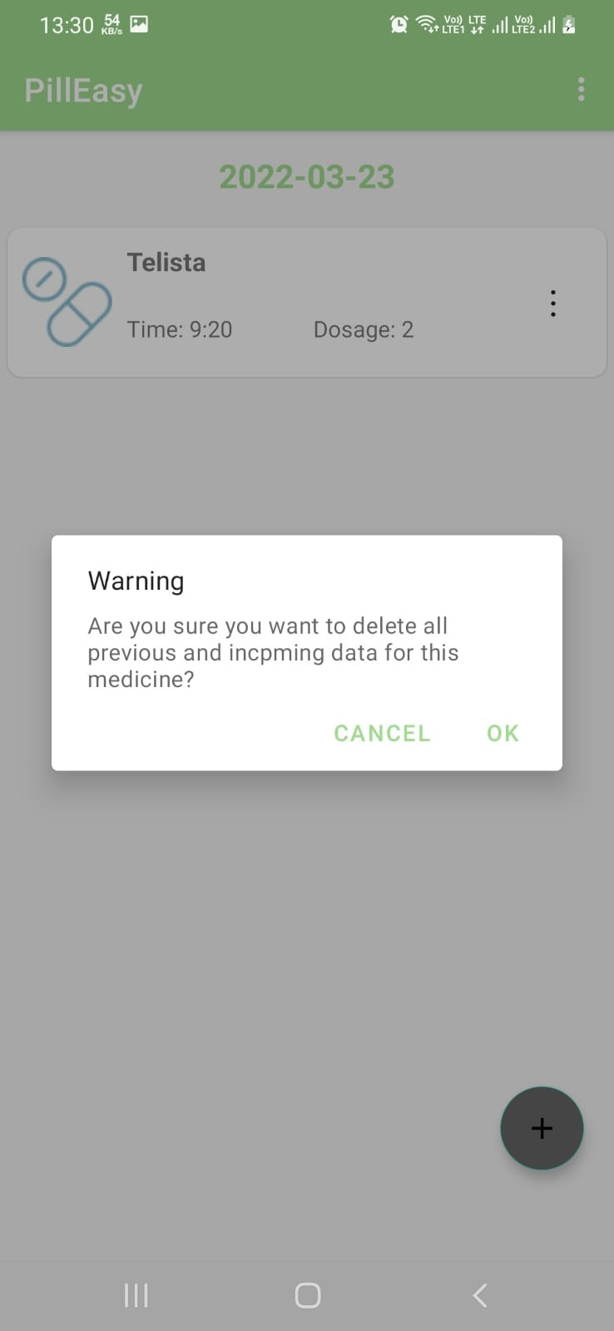
WORKING DEMO ACTIVITY-5

Slide 12
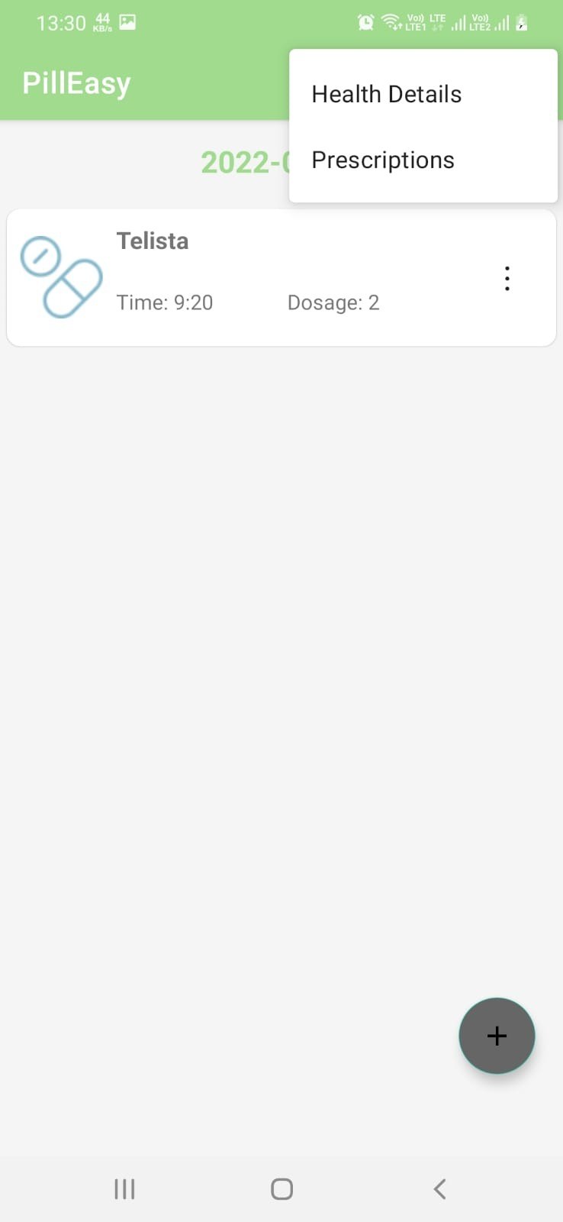
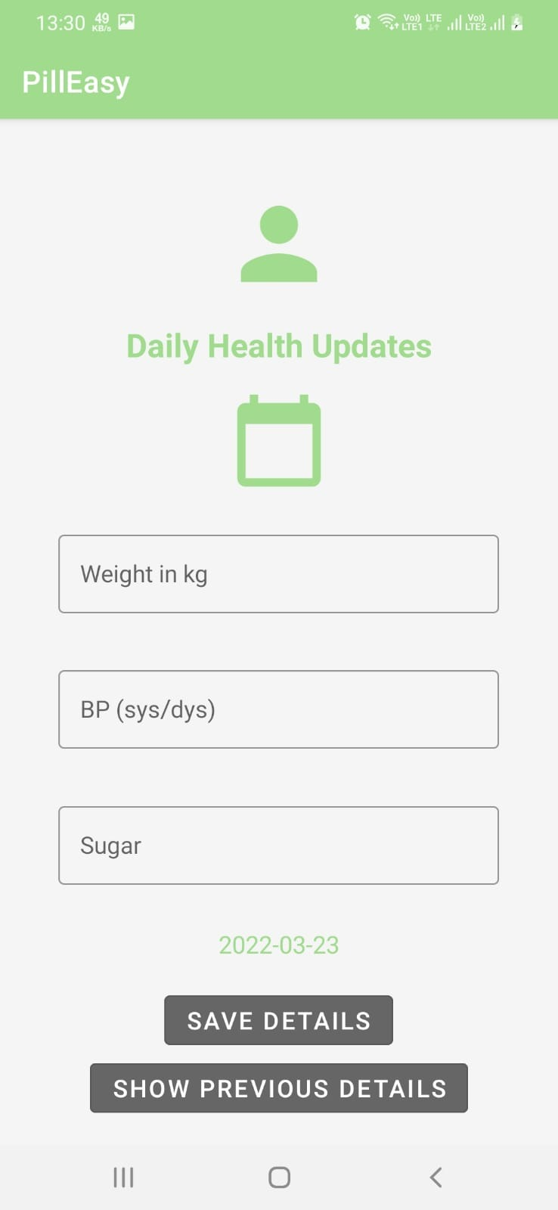
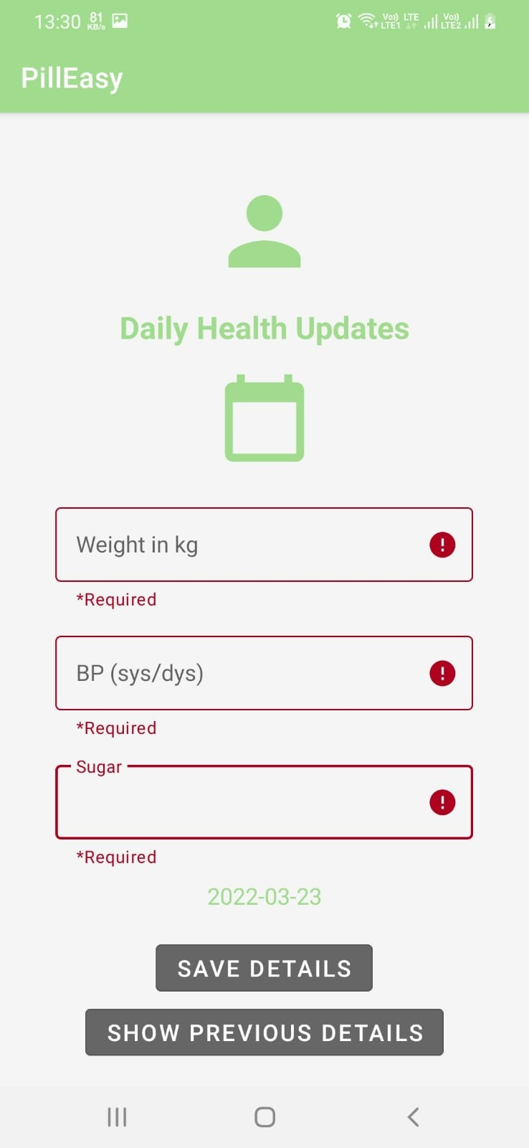
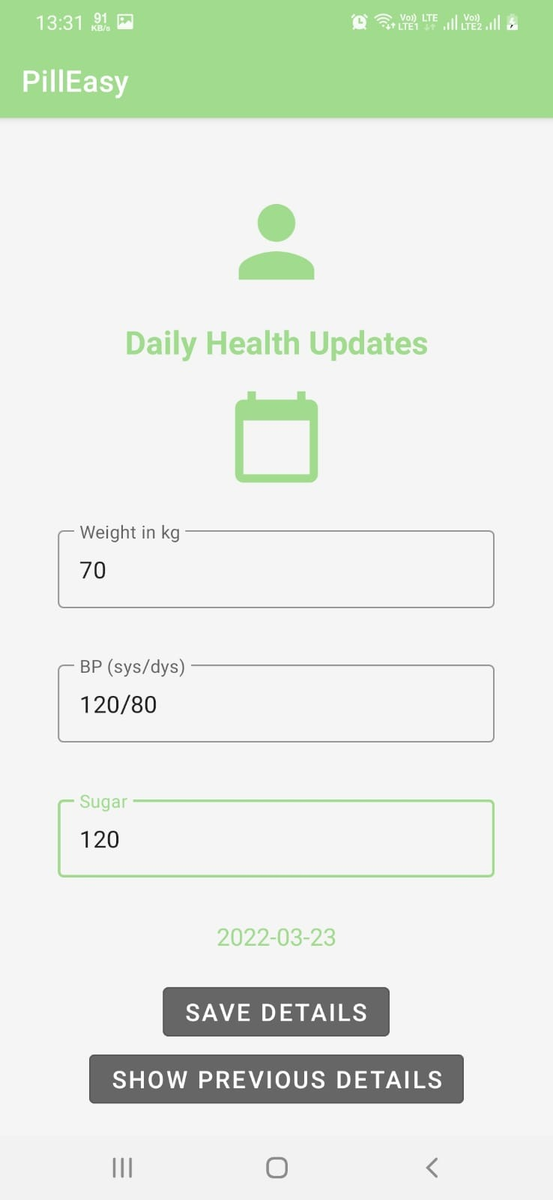
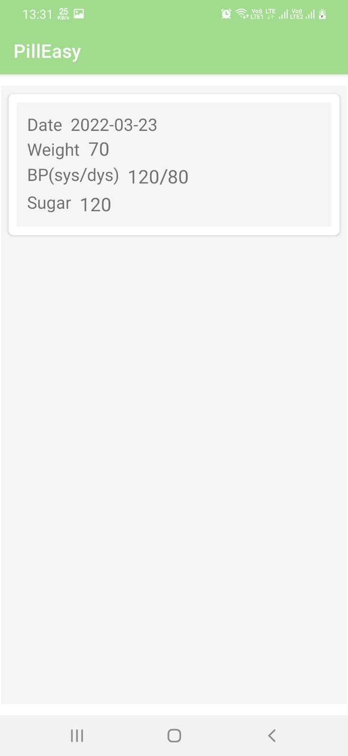
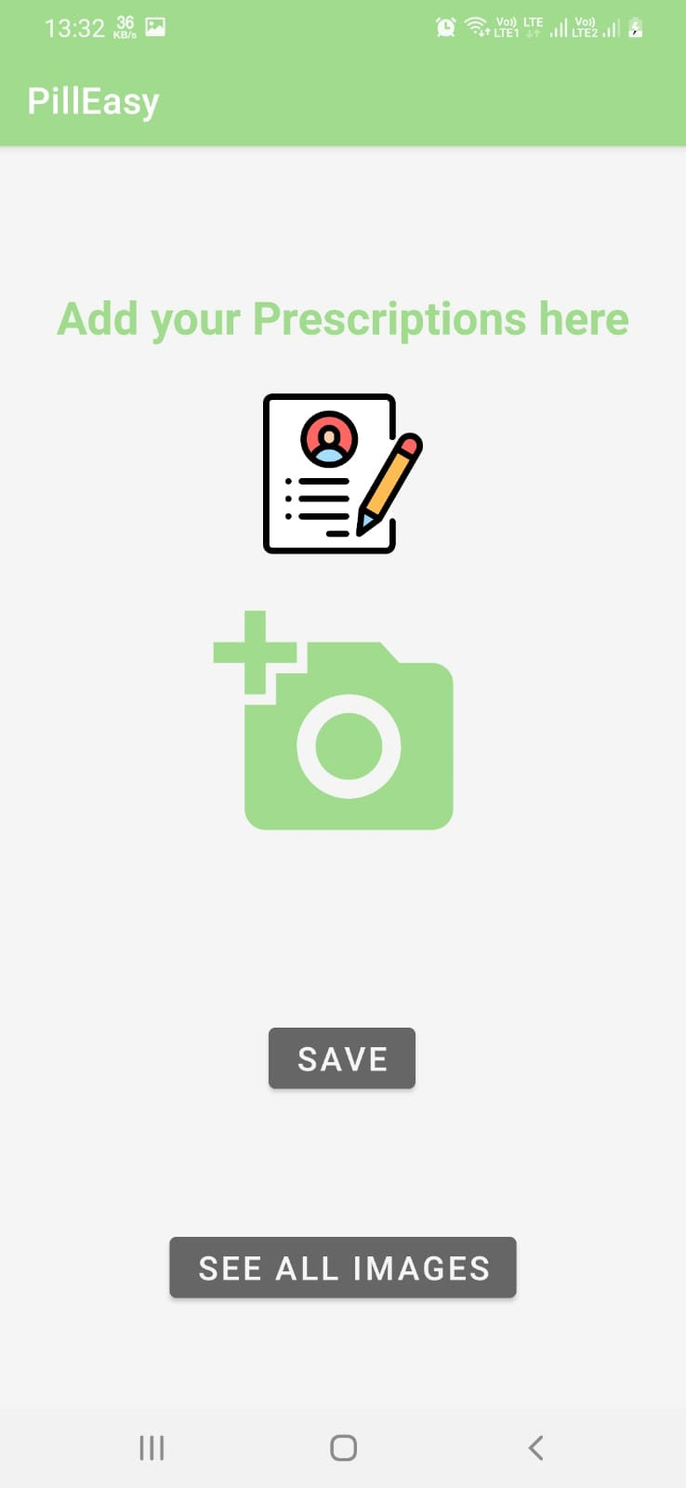
WORKING DEMO ACTIVITY-6

Slide 13
FEATURES YET TO BE IMPLEMENTED
The monthly report of Health updates to be sent to the login Email in a pdf format
Medicine name to be extracted from its strip using Computer Vision.
Add and save images of prescription
Users can edit the Medicine doses, alarm times etc.
With the reminder there is a pop-up that has options as (Take/Ignore)
If you click on ‘take’, the notification/ alarm will be set to off,otherwise
Notification will snooze for some time and again remind you of the medicine with notification sound.

Slide 14
TOOLS & TECHNOLOGY USED
Android Studio
SQLite Database
Android Programming using Java
Google Material Design

Slide 15
OUTCOME
The outcome of the project will be a fully fledged app which will be a one stop solution that will suit users behaviour and needs. While using this app, user will not miss any of their medications and will also be helpful for tracking his/her weight, Blood Pressure and Diabetes.

Slide 16
CONTRIBUTION
Madiha Tariq (MT21125): SignUp and Login implementation
Harshit Gupta (MT21028) : Landing page (where all medicine with its corresponding dose ,time and date)
Niharika (MT21132): Walkthrough Screen, Health Details and Prescriptions Layout form
Shrey Rastogi (MT21145):- Medicine name and medicine intake type selection view.
Mohnish Basarkar (MT21052) : Added reminders and schedule sections along with taking picture of medicine strip.

Slide 17
REFERENCES
https://developer.android.com/docs
https://material.io/design
https://www.sqlite.org/docs.html

Slide 18
THANK YOU
ANY QUESTION?

